Slide 1
DAH2F3 Perencanaan Sumber Daya Perusahaan
Minggu ke-3: Procurement
P r o d i D 3 K o m p u t e r i s a s i A k u n t a n s i F I T , U n i v e r s i t a s T e l k o m

Slide 2
AGENDA
Deskripsi dan kegiatan tiap proses dalam siklus/proses bisnis
Komponen
Integrasi dengan komponen lain
Elemen organisasi yang terkait proses ini
Master data yang terkait proses ini
Transaksi tiap proses
Dokumen hasil transaksi
Reference:
SAP. (2006). SAP01: SAP Overview. SAP AG.

Slide 3

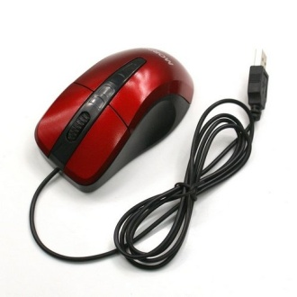
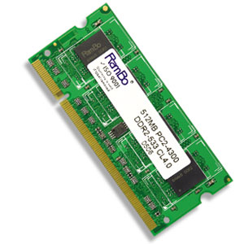
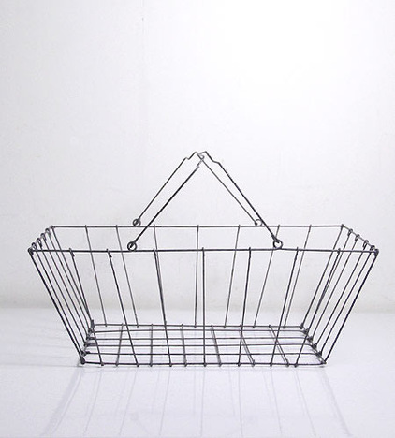
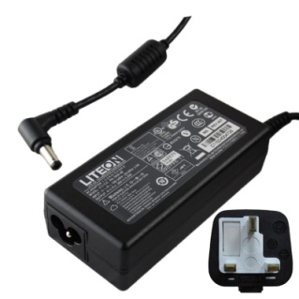

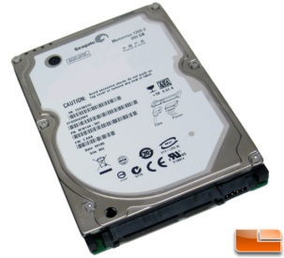
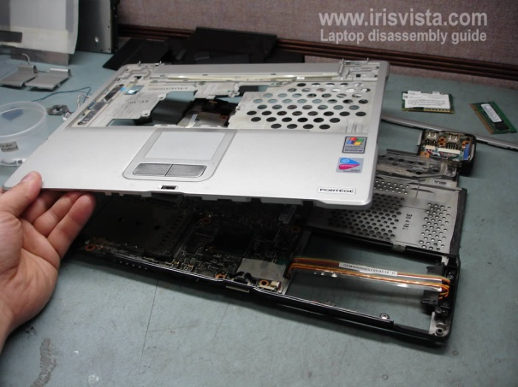
Pengadaan
(Procurement)
Produksi
(Production)
Penjualan
(Sales Order)
Notes:
Jelaskan scope logistik secara umum. Materi kali ini hanya di procurement saja.

Slide 4

Agenda
Lesson: Logistics
Procurement
Sales Order Management
Production

Slide 5
Games: Role Play
Mahasiswa adalah karyawan di Toko Electronic Solution yang menjual banyak perlengkapan elektronik, termasuk computer.
Bagi mahasiswa menjadi
Department Procurement
Department Warehouse
Department Accounting
Department Sales
Vendor beberapa Merk computer ternama.
Setiap department mengajukan “LAPTOP”
untuk dipakai oleh karyawannya
Bebaskan mahasiswa menentukan kebutuhan dan spesifikasi “LAPTOP”
Tuliskan dalam dokumen “Purchase Requisition”
Untuk dijual lagi
Bebaskan mahasiswa menentukan kebutuhan dan spesifikasi “LAPTOP”
Tuliskan dalam dokumen “Purchase Requisition”
Department Procurement merekap data dari semua department
Notes:
Dosen dapat melaksanakan Roleplay hingga selesai, dilanjutkan dengan penjelasan
Atau
Dosen dapat melaksanakan Roleplay per proses “Procurement”, didampingi dengan penjelasan. Lanjutkan Roleplay lagi dengan penjelasan dst
Atau
Dosen memberikan penjelasan dan diakhiri dengan Roleplay dilaksanakan diakhir sesi perkuliahan,

Slide 6
Games: Role Play (Conts)
Department Procurement mengirimkan “Request For Quotation” ke Vendor
Berisi spec dan qty
Departemen Procurement menerima “Quotation” dari semua vendor dan menyeleksi SATU Vendor berdasarkan “Quotation” tersebut
Departemen Procurement mengirimkan “Purchase Order (PO)” ke Vendor Terpilih
Departemen Procurement melakukan monitoring terhadap PO yang dikirimkan
Department Warehouse menerima “LAPTOP” dari Vendor dan dicatat dalam “Goods Receipts”
Department Warehouse memverifikasi invoice
Departemen Accounting menerima pembayaran

Slide 7
Lesson: Procurement
Lesson Overview
Explain procurement process
How procurement process is integrated within other solution
Lesson Objectives
Outline the tasks associated within the procurement cycle
Explain how SAP within mySAP ERP supports the key processes in Procurement

Slide 8


Dijual atau
Dipakai sendiri
Process Procurement
Requisition,
Purchase order management,
Invoice verification
Procurement via
Purchasing Department
Department in need
Notes:
Proses umum
Requisition → Permohonan Kebutuhan
Purchase order management → Permintaan Pembelian
Invoice verification → Verifikasi tagihan
Cara pengadaan:
Purchasing Department
Department in need → menggunakan catalog-based self-service requisitioning for maintenance
biasanya untuk barang MRO (maintenance, repair, operations) cth. ATK, seragam kantor, komputer kantor)

Slide 9
Procurement process Overview
Procurement in mySAP ERP improves procurement processes:
Facilitating plan-driven and ad hoc purchasing,
complete inventory management,
intelligent reporting on all procurement activities,
Providing supplier relationship management tools

Slide 10
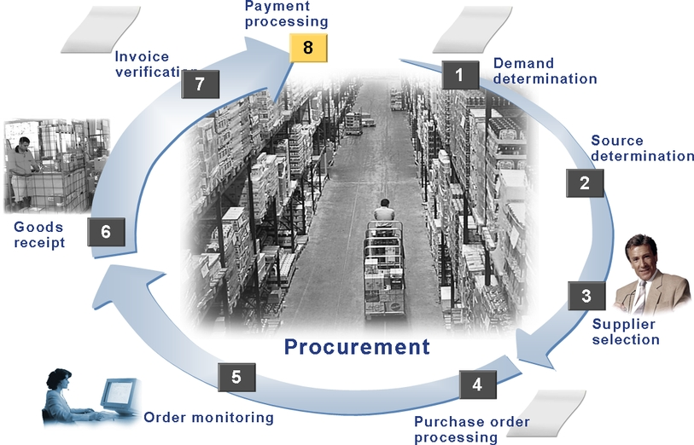
Procurement process Overview

Slide 11
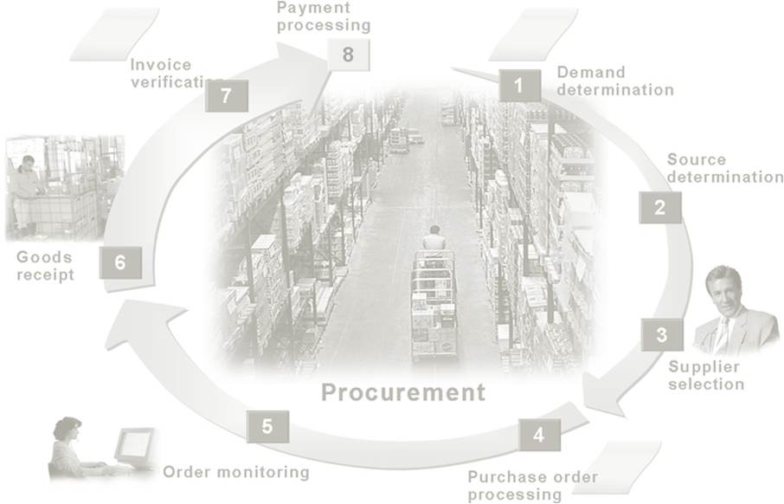

Procurement Process Overview
Material requirements are identified
Via user departments
“You can enter purchase requisitions yourself”
or
via materials planning and control
“generated automatically”
 Purchase Requisition

Slide 12
Procurement Process Overview
Self-Service Procurement
All employees can create and manage their own requisition.
System provide frequently order catalog
Self-service requisition = purchase non-strategic goods (not directly linked to the value chain)

Slide 13

Procurement Process Overview
Identify potential
sources of supply based on past orders and existing longer-term purchase agreements
How? One of them is creating
requests for quotation (RFQs) sent electronically via EDI
 Request For Quotation

Slide 14

Procurement Process Overview
Simulation
simulating pricing scenarios, comparing a number of different quotations.
Decision
Rejection letters can be sent automatically.
 Quotation

Slide 15

Procurement Process Overview
Generating PO
Generate PO yourself
or
Automatically
 Purchase Order

Slide 16
Purchase Order (PO)
a formal request to a vendor to supply certain goods or services under the stated conditions.

Slide 17
Purchase Order (PO)
How to create PO?
Without reference
With reference to a purchase requisition
Request for quotation
Another PO

Slide 18

Procurement Process Overview
Remainder
Printed
Expediters at specified interval
Up to date status of all Purchase Requisition, Quotation, and PO

Slide 19

Procurement Process Overview
Source of Goods Receipt is PO
Company can specify the limit permissible tolerance with defining over- and under- of order goods
 Good Receipt/Material Doc

Slide 20
Procurement Process Overview
Inventory Management
Advantage of posting GR to stock with reference to PO:
1. Goods delivered? And Delivery = PO data?
2. Easy to enter GR and check over/under-delivery
3. PO history automatically updated
4. When posting GR to warehouse, material doc (material, qty, str.loc) created.
5. Create accounting doc that record good movements on value stock

Slide 21

Procurement Process Overview
Checking and matching of invoices and credit memo
Payment and evaluation of invoices not part of invoice verification
Invoice verification create a link between procurement and accounting

Slide 22
Procurement Process Overview
Posting
Invoice with reference to PO:
System suggest data form PO and GR for PO
PO ≠ GR ≠ invoice → system warn user and block invoice payment
PO = GR = invoice → system update PO history and Financial Accounting initiate payment for the open invoice item

Slide 23
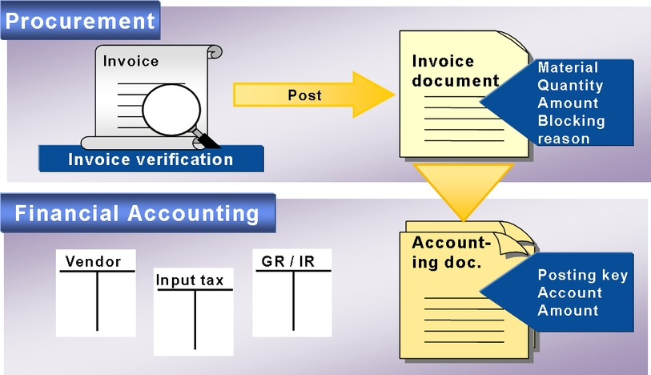
Procurement Process Overview

Slide 24
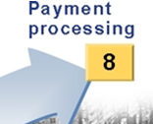
Procurement Process Overview
Payment is part of Financial Accounting process

Slide 25
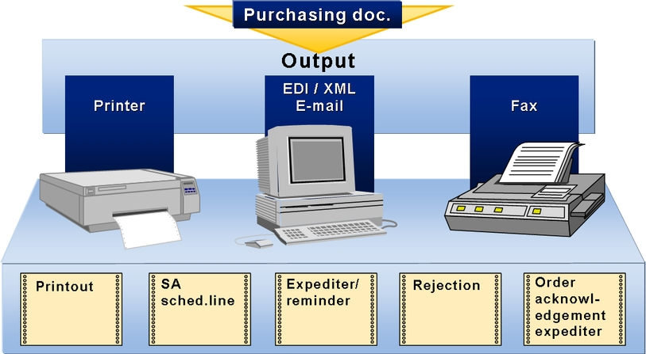
Messages
Notes:
self-service requisitioning = untuk barang2 kecil (ATK, RAM rusak)

Slide 26
Messages
Each time you create purchasing doc (RFQ, PO, Contract, Scheduling Agreement) , the system can create message form the document affected.
Messages are queued.
The queue option:
Issue immediately
Issue later
Notes:
self-service requisitioning = untuk barang2 kecil (ATK, RAM rusak)

Slide 27
Additional Information
Good Receipt
Invoice verification
Payment processing
Stock $xxx
GR/IR $xxx
GR/IR $xxx
A/P $xxx
A/P $xxx
Cash $xxx

Slide 28
Procurement process Summary
Unit: Accounting
Exercise 5-2
Unit: MM Logistics
Invoice Verification
Exercise 4-3
Unit: MM Purchase
Doc: Purchase Requisition
Unit: MM Purchase
Doc: Request For
Quotation
Unit: MM Inventory
Doc: Good Receipt
Exercise 4-2
Unit: MM Purchase
Doc: Quotation
Unit: MM Purchase
Doc: Purchase Order
Exercise 4-1
Unit: MM Purchase
Doc: Order Acknowledement

Slide 29
End of This Session

